Slide 1
Association Rule Mining
- MaxMiner

Slide 2
Mining Association Rules in Large Databases
Association rule mining
Algorithms Apriori and FP-Growth
Max and closed patterns
Mining various kinds of association/correlation rules

Slide 3
Max-patterns & Close-patterns
If there are frequent patterns with many items, enumerating all of them is costly.
We may be interested in finding the ‘boundary’ frequent patterns.
Two types…

Slide 4
Max-patterns
Frequent pattern {a₁, …, a₁₀₀} → (₁₀₀¹) + (₁₀₀²) + … + (₁¹₀⁰₀⁰) = 2¹⁰⁰-1 = 1.27*10³⁰ frequent sub-patterns!
Max-pattern: frequent patterns without proper frequent super pattern
  BCDE, ACD are max-patterns
  BCD is not a max-pattern
Tid | Items
10 | A,B,C,D,E
20 | B,C,D,E,
30 | A,C,D,F
Min_sup=2

Slide 5
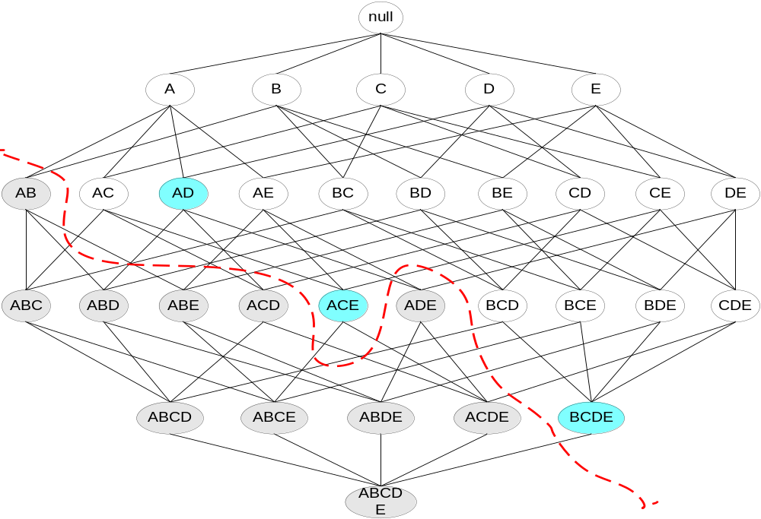
Maximal Frequent Itemset
An itemset is maximal frequent if none of its immediate supersets is frequent
Maximal Itemsets
Infrequent Itemsets
Border

Slide 6
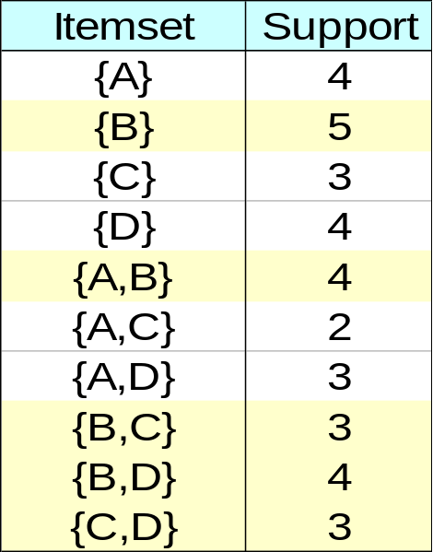
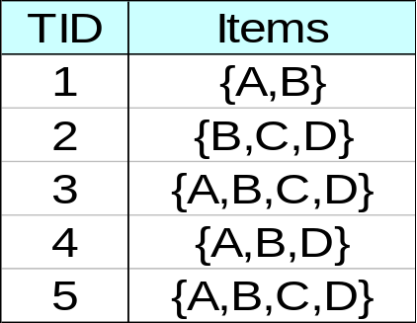
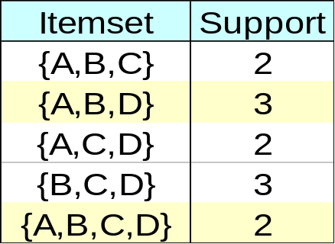
Closed Itemset
An itemset is closed if none of its immediate supersets has the same support as the itemset

Slide 7
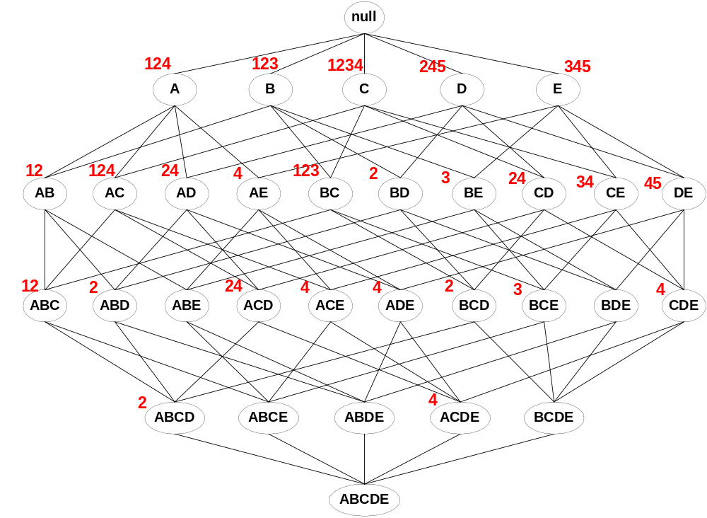
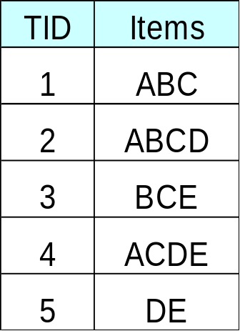
Maximal vs Closed Itemsets
Transaction Ids
Not supported by any transactions

Slide 8
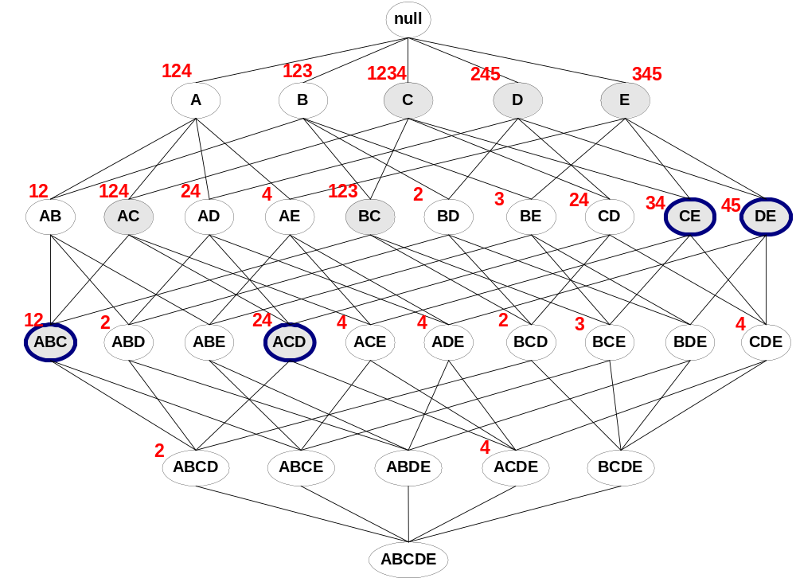
Maximal vs Closed Frequent Itemsets
Minimum support = 2
Closed but not maximal
Closed and maximal
# Closed = 9
# Maximal = 4

Slide 9
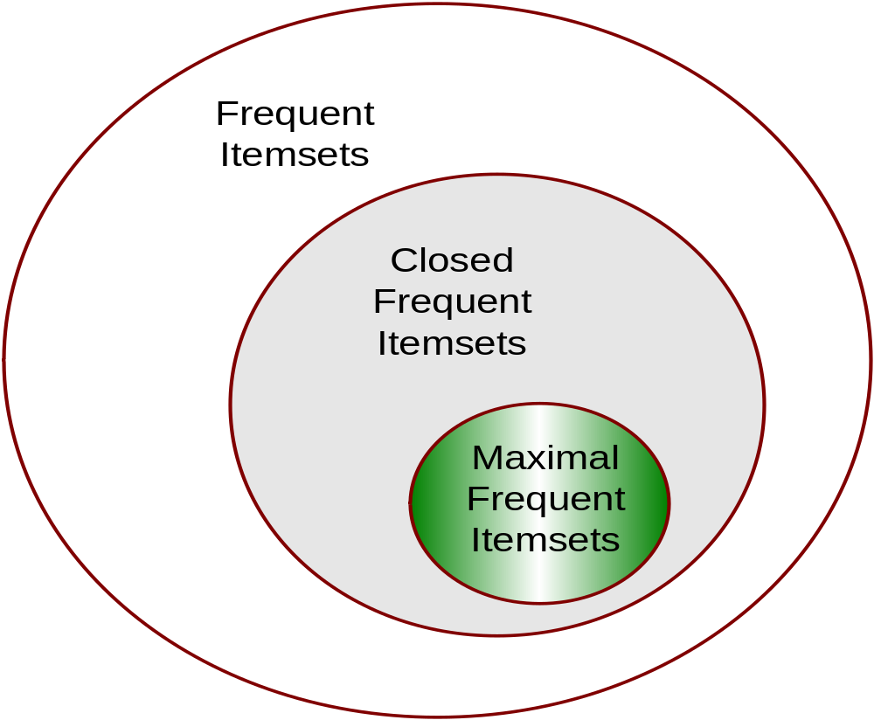
Maximal vs Closed Itemsets

